Slide 1


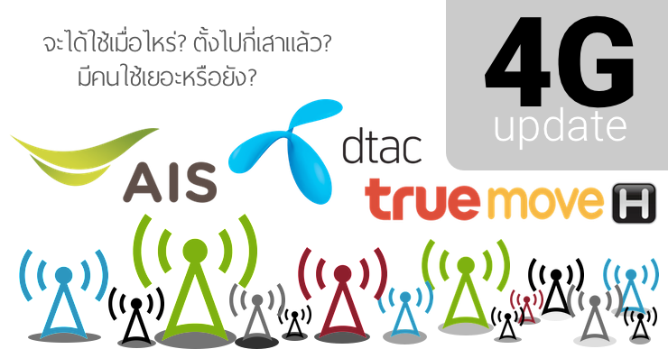
KPI June 2023 Monthly Report R1_UN
01 – 30 Jun 2023 @Managed Service (Chiang Mai)
Event Over all = 17267 Ticket +900/1800 = 4088 TT +2600 = 447 TT
+700 = 143 TT
Present by : Santisuk Suthanma
Date : 19 Jul 2023
Managed Service

Slide 2
Agenda KPI Monthly Jun 2023
1. KPI Performance
2. Trend Main Power failure
3. Repeat Fault
4. Cause of fault
5. Over SLA
6. Fault Fiber Optic
Managed Service

Slide 3
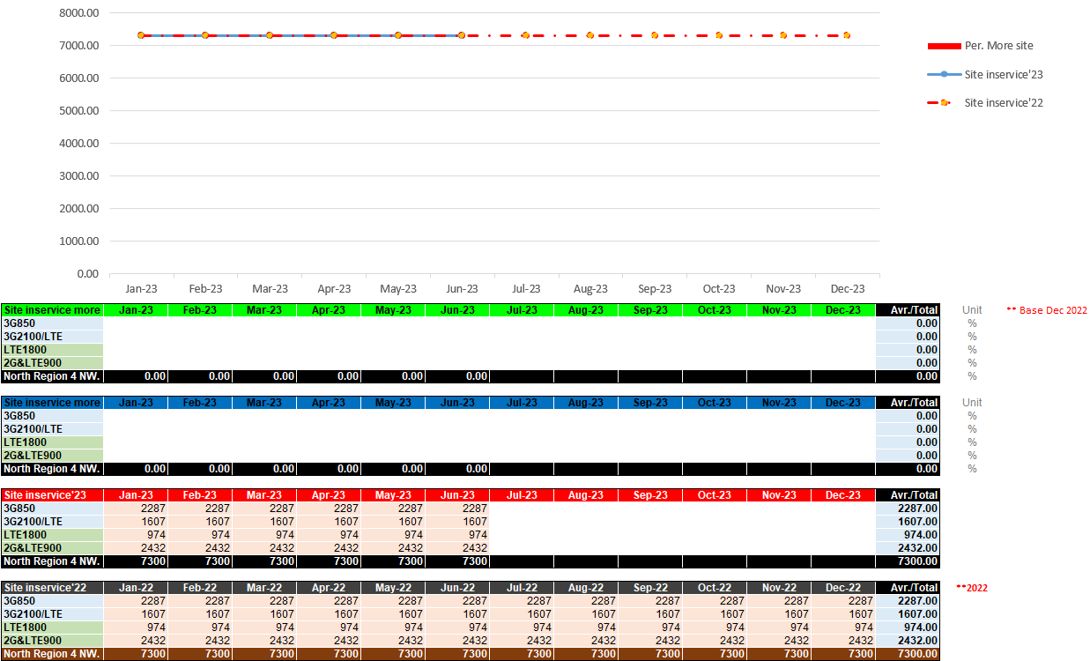
Site in-services
Managed Service

Slide 4
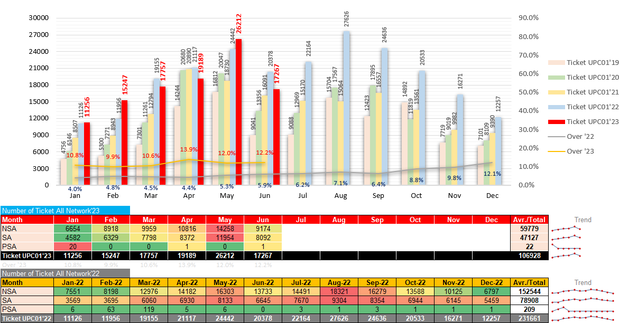
Compare Ticket 2022 vs. 2023
Managed Service

Slide 5
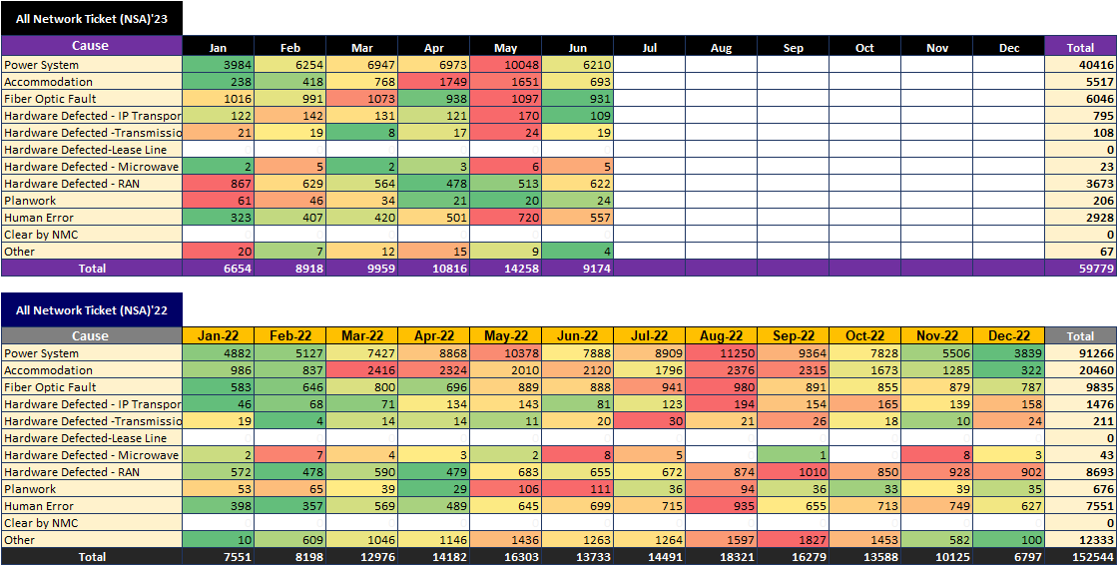
Compare Ticket 2022 vs. 2023
Managed Service

Slide 6
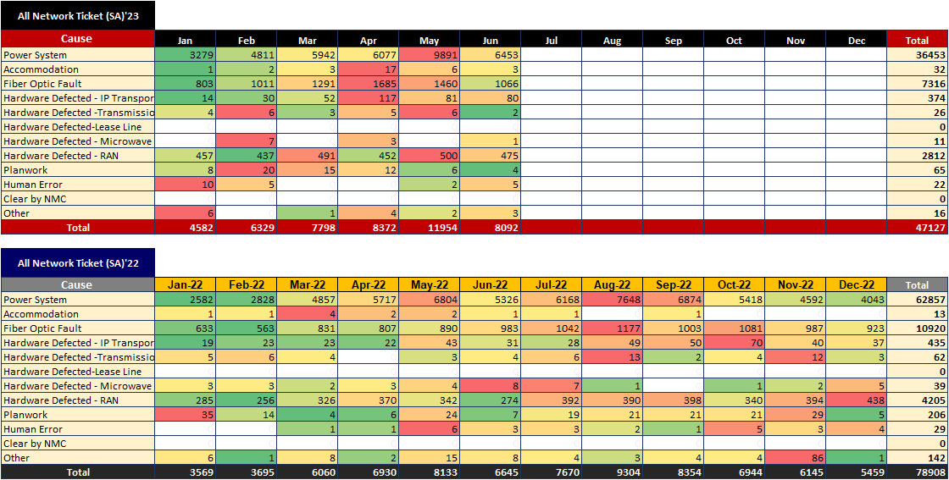
Compare Ticket 2022 vs. 2023
Managed Service

Slide 7
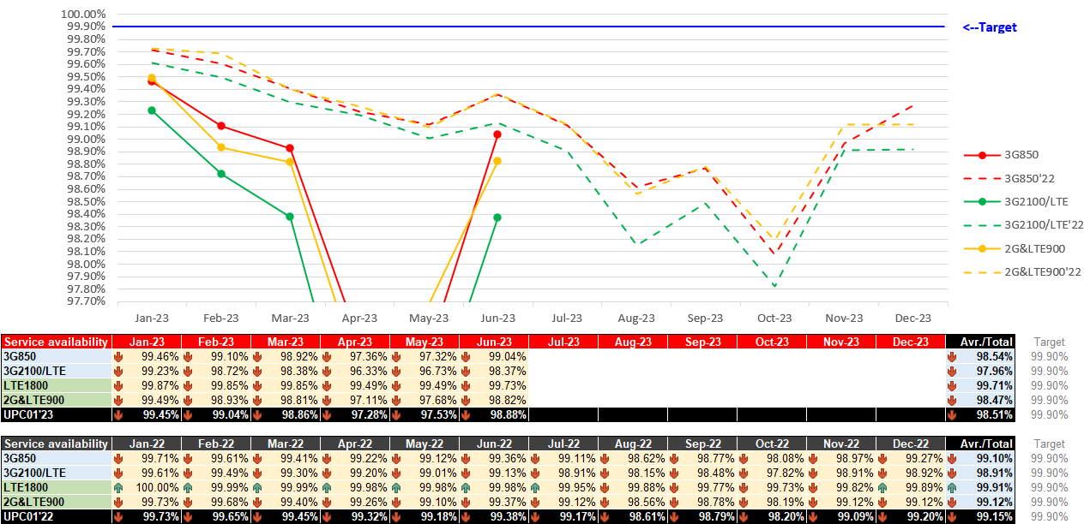
All Service availability compare
Managed Service

Slide 8
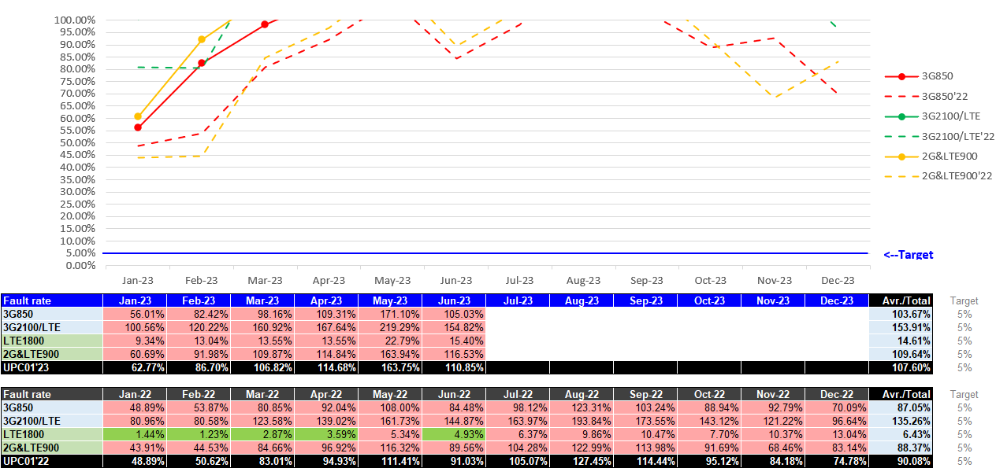
All Fault rate compare
Managed Service

Slide 9
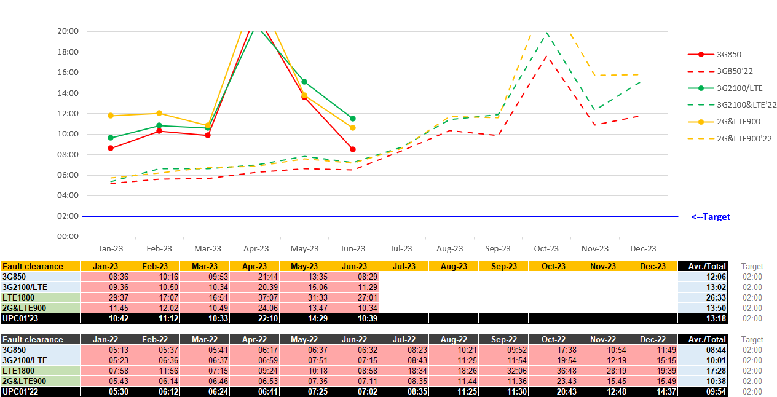
All Fault clearance compare
Managed Service

Slide 10
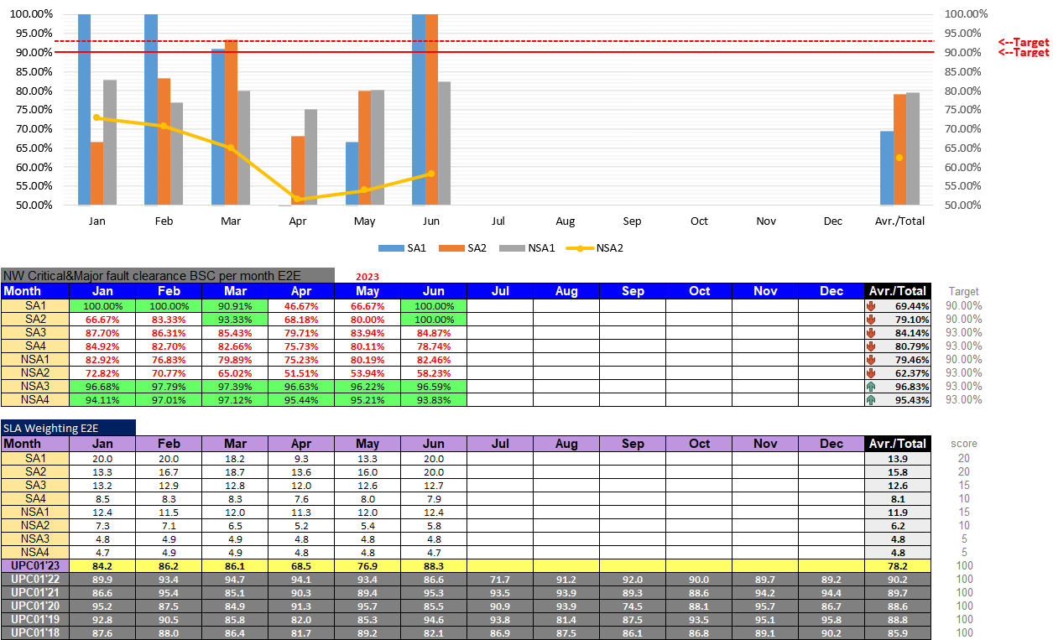
Major fault clearance BSC/SLA Weighting E2E
Managed Service

Slide 11
Network Performance All
- SA KEY Performance
- NSA KEY Performance
- Fault clearance time
- NW Availability & Fault rate
Managed Service

Slide 12
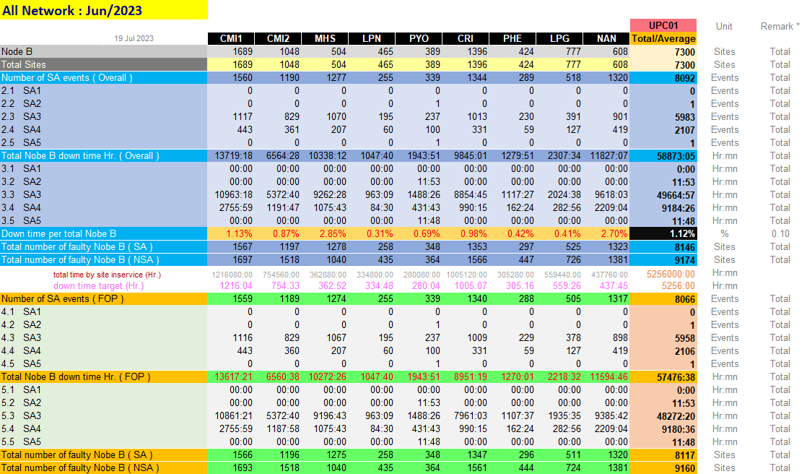
KPI Monthly Jun 2023
Ticket (All) SA KEY PERFORMANCE INDICATOR REPORT
Managed Service

Slide 13
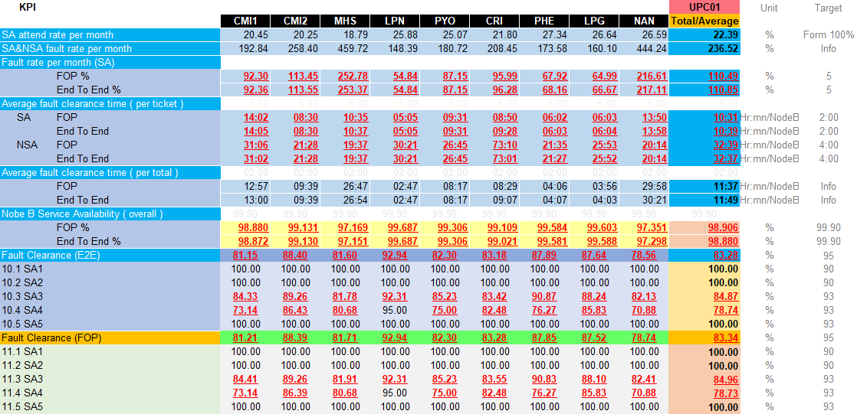
KPI Monthly Jun 2023
Ticket (All) SA KEY PERFORMANCE INDICATOR REPORT
Managed Service

Slide 14
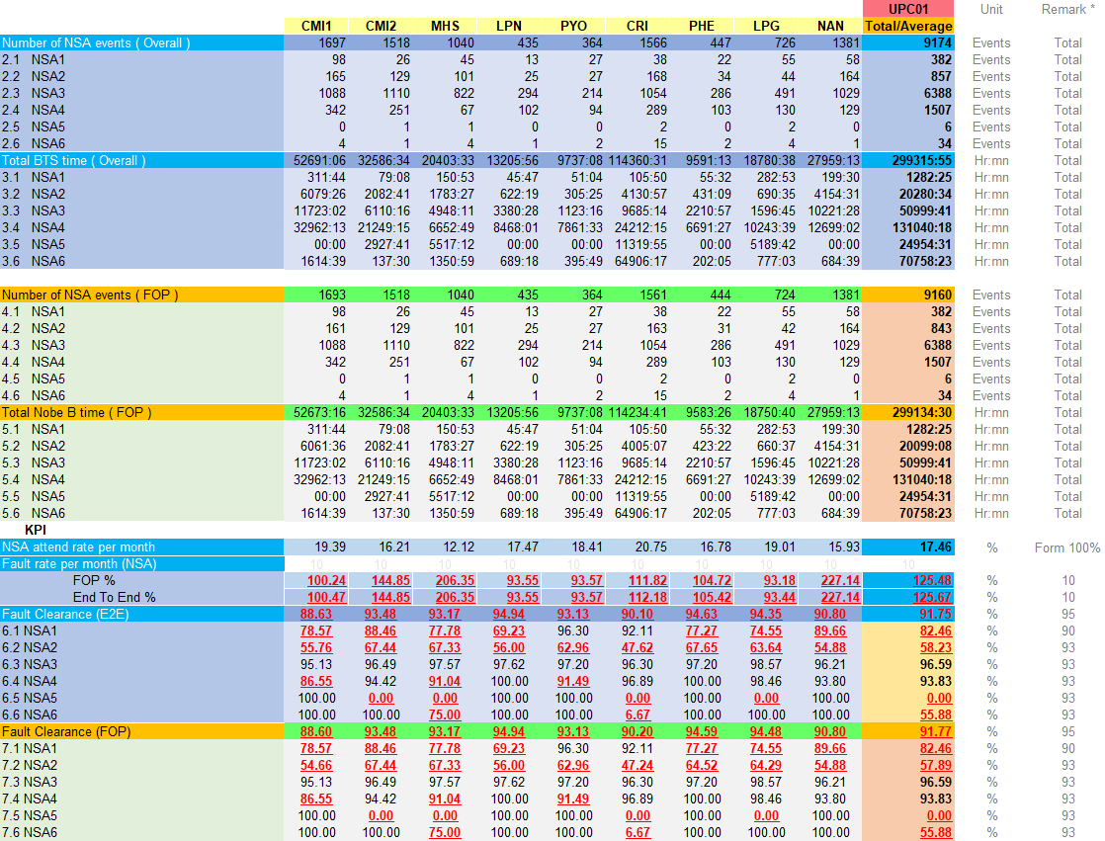
KPI Monthly Jun 2023
Ticket (All) NSA KEY PERFORMANCE INDICATOR REPORT
Managed Service

Slide 15
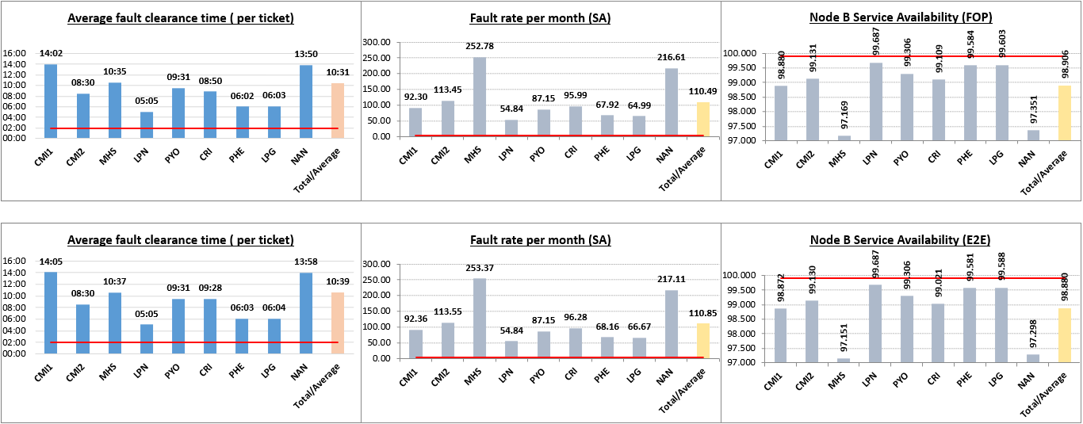
(All) Fault clearance time / Fault rate /NW Availability (E2E & FOP)
TaRget = 2:00 hr
TaRget = 5 %
TaRget = 99.90 %
FOP
End to End
Managed Service

Slide 16
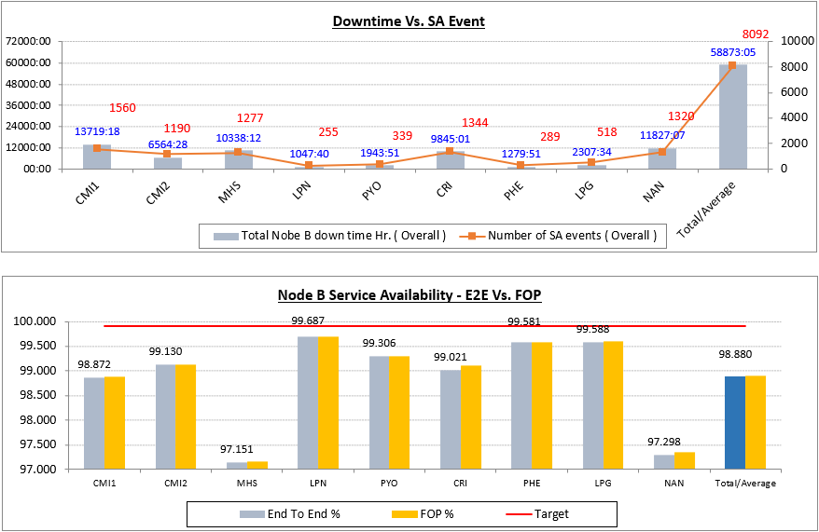
(All) Compare NW Availability & Down Time Ticket
TaRget = 99.90 %
Managed Service

Slide 17
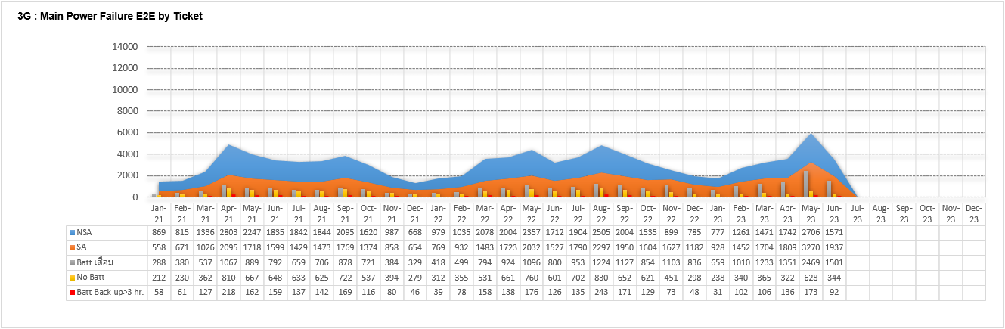
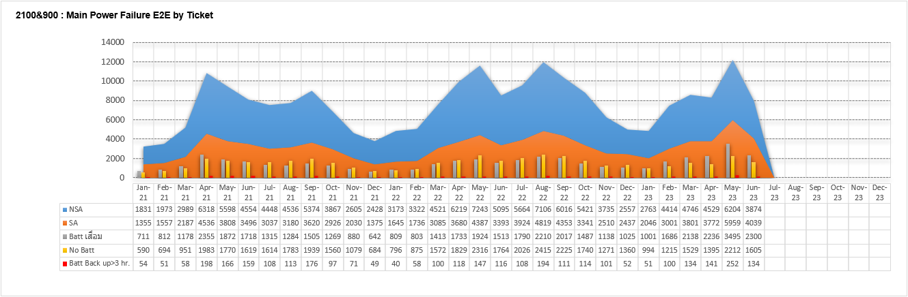
Trend Main Power failure in Year 2023
UPC01 2021
UPC01 2022
UPC01 2023
UPC01 2021
UPC01 2022
UPC01 2023
Managed Service

Slide 18
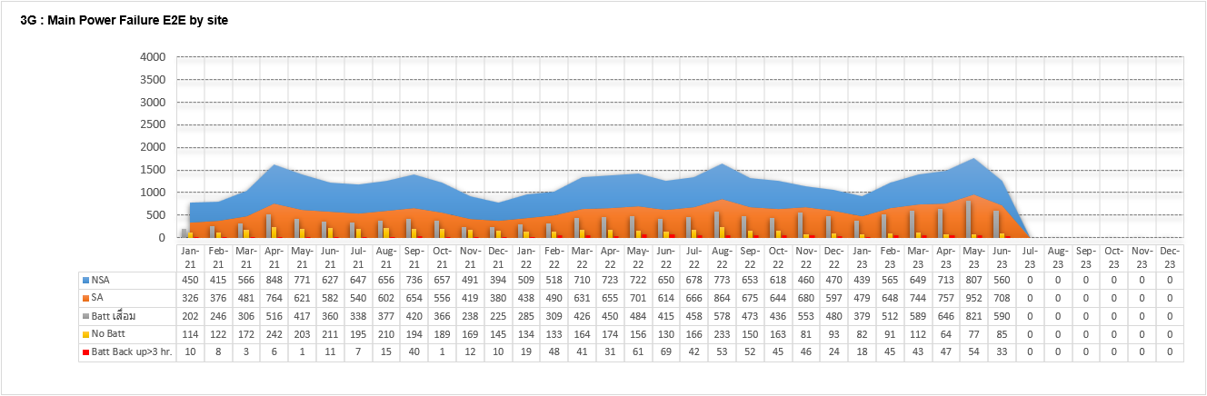
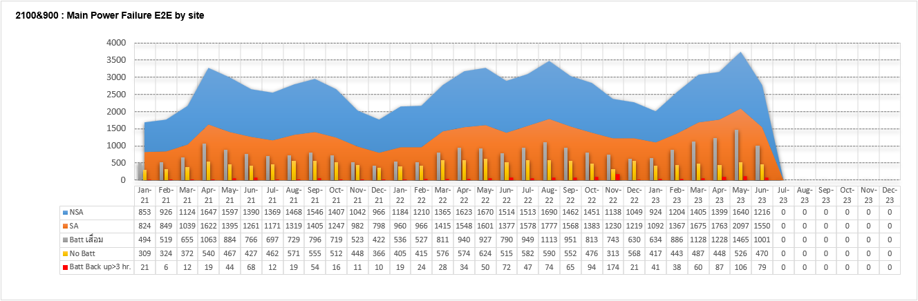
Trend Main Power failure in Year 2023 By Site
UPC01 2021
UPC01 2022
UPC01 2023
UPC01 2021
UPC01 2022
UPC01 2023
Managed Service

Slide 19
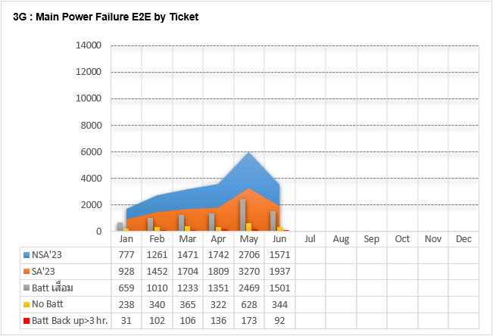
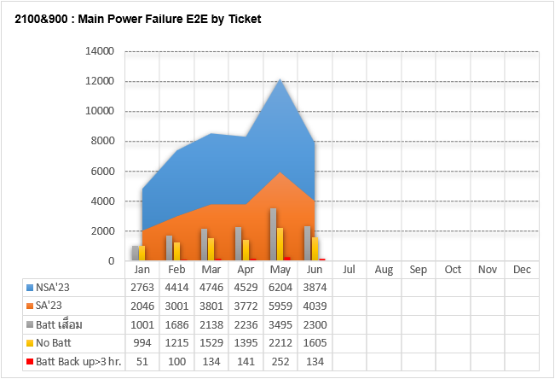
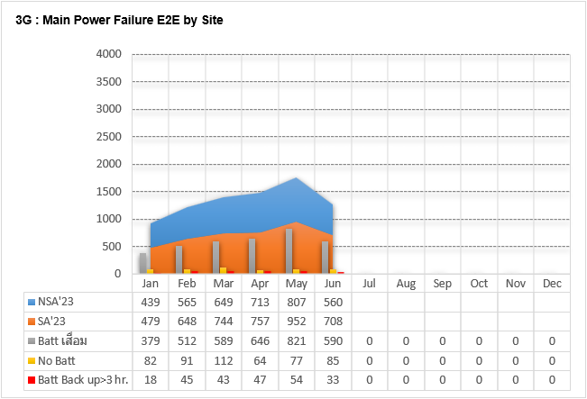
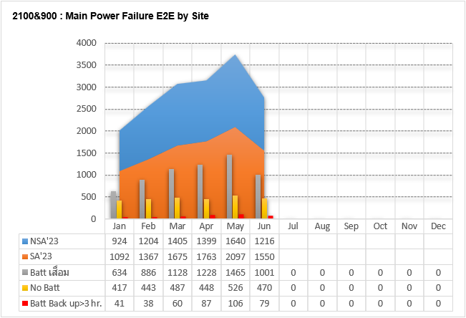
Trend Main Power failure in Year 2023 By Ticket & Site
Managed Service

Slide 20
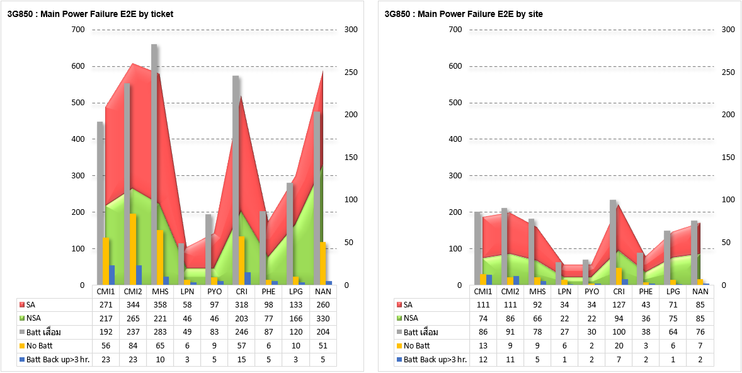
(3G850) Main Power Failure & Site Down By Ticket &Site
Managed Service

Slide 21
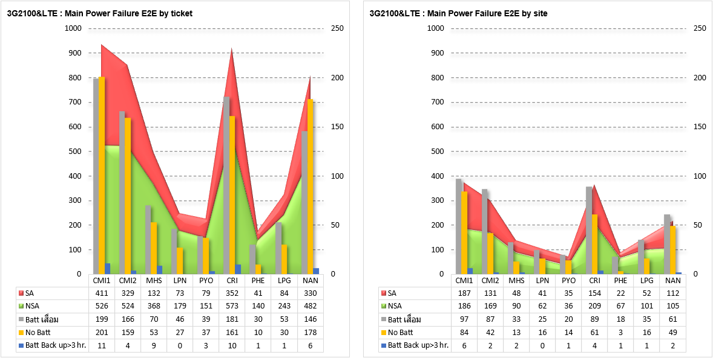
(3G2100&LTE) Main Power Failure & Site Down By Ticket &Site
Managed Service

Slide 22
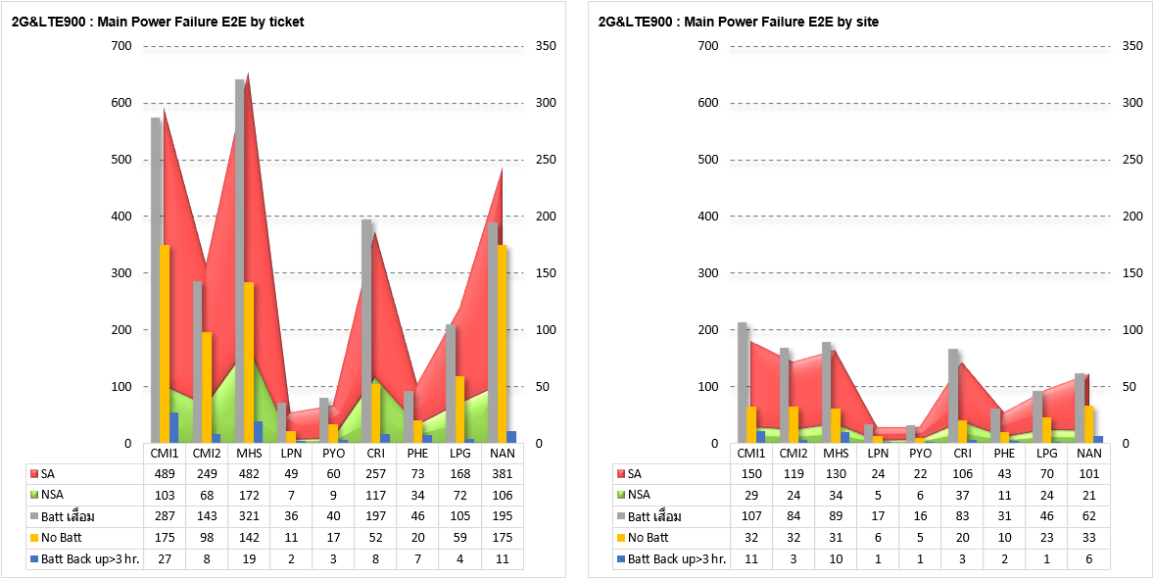
(2G+LTE900) Main Power Failure & Site Down By Ticket &Site
Managed Service

Slide 23
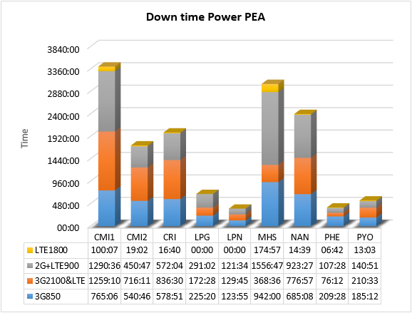
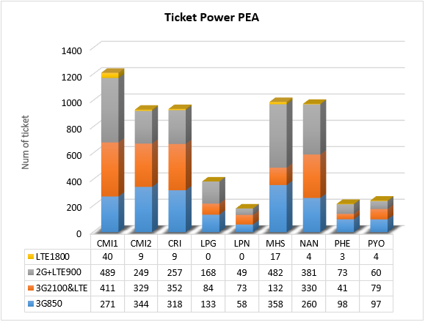
(All) Main Power Failure & Site Down By Down time vs. Ticket
Managed Service

Slide 24
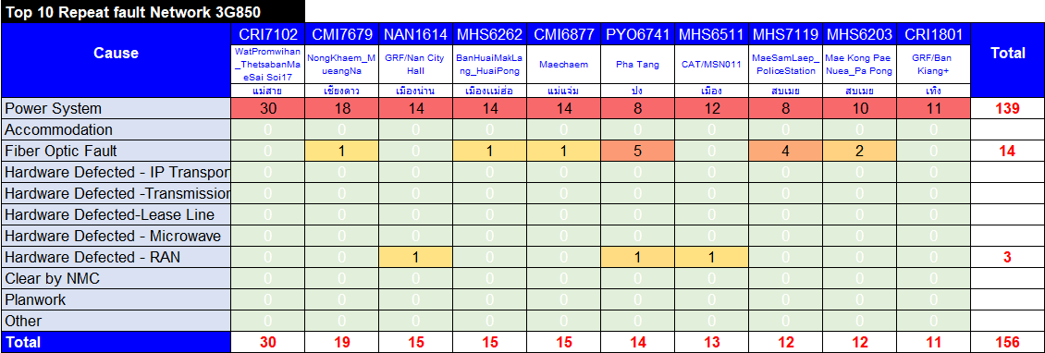
(3G850) Repeat Fault Apr 2023 (SA)
Repeat Fault all
Managed Service

Slide 25
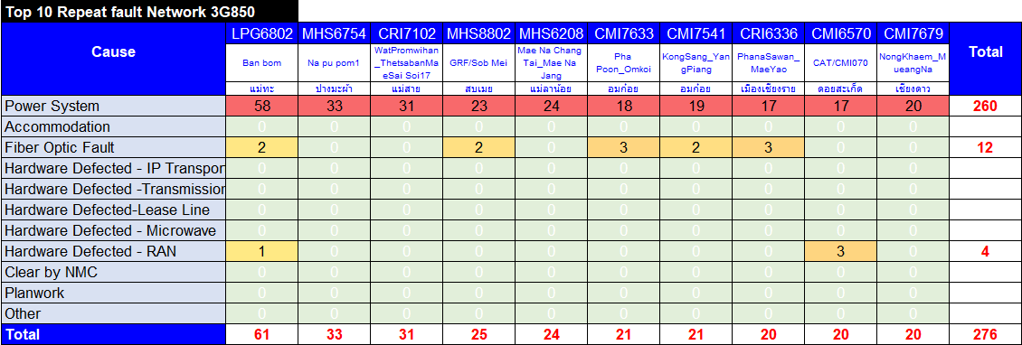
(3G850) Repeat Fault May 2023 (SA)
Repeat Fault all
Managed Service

Slide 26
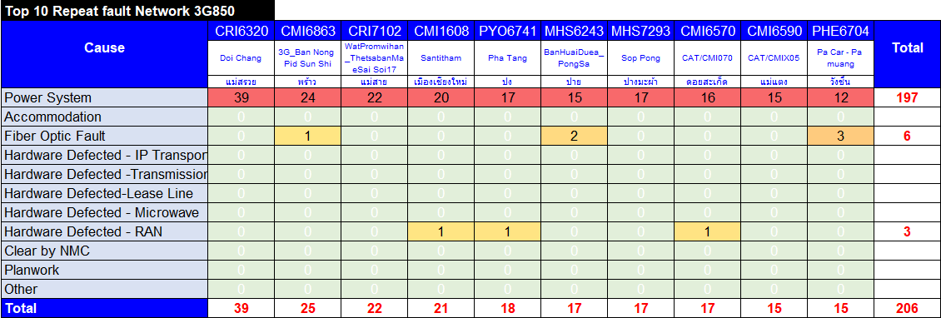
(3G850) Repeat Fault Jun 2023 (SA)
Repeat Fault all
Managed Service

Slide 27
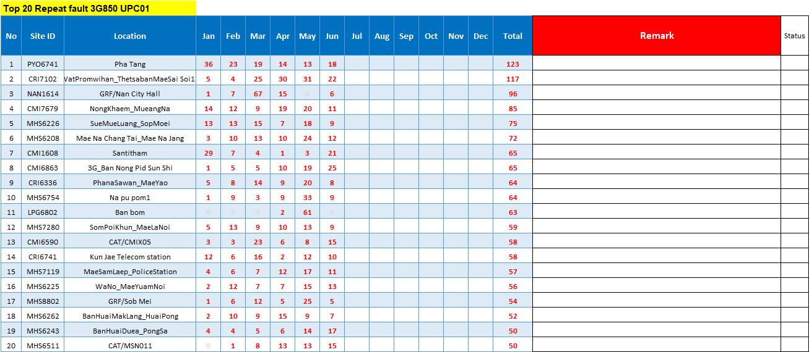
(3G850) Top 20 Repeat Fault by ticket Nor.1 (SA)
Managed Service

Slide 28
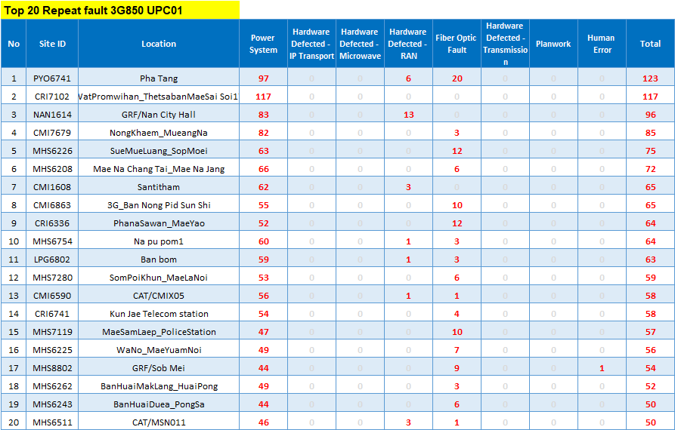
(3G850) Top 20 Repeat Fault by cause Nor.1 (SA)
Managed Service

Slide 29
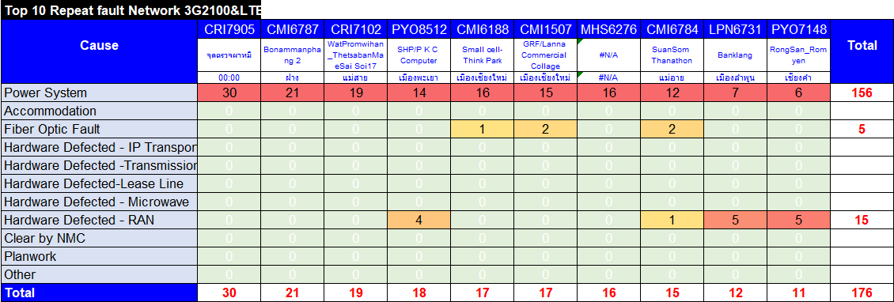
(3G2100&LTE) Repeat Fault Apr 2023 (SA)
Repeat Fault all
Managed Service

Slide 30

(3G2100&LTE) Repeat Fault May 2023 (SA)
Repeat Fault all
Managed Service

Slide 31
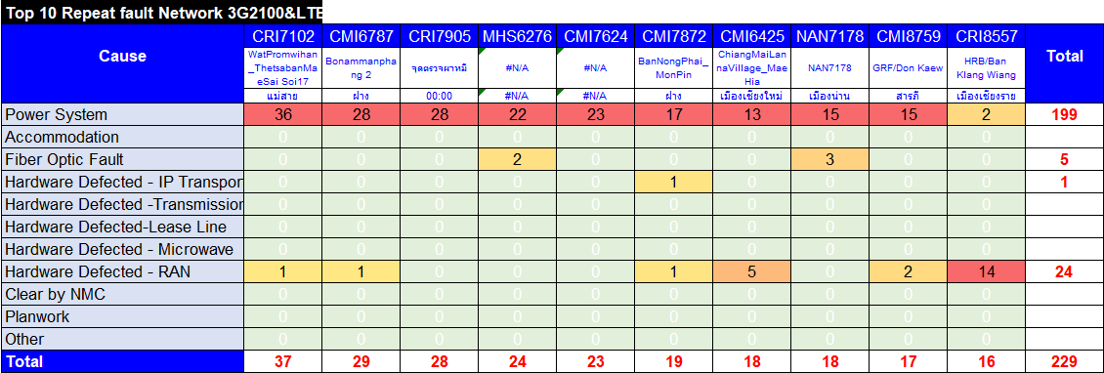
(3G2100&LTE) Repeat Fault Jun 2023 (SA)
Repeat Fault all
Managed Service

Slide 32
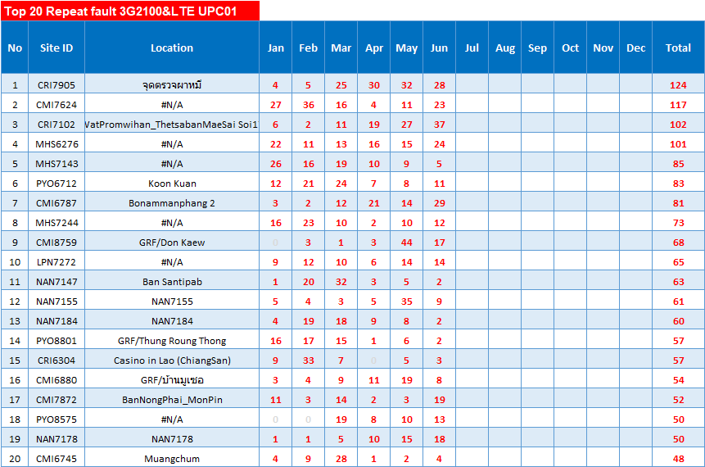
(3G2100&LTE) Top 20 Repeat Fault by ticket Nor.1 (SA)
Managed Service

Slide 33
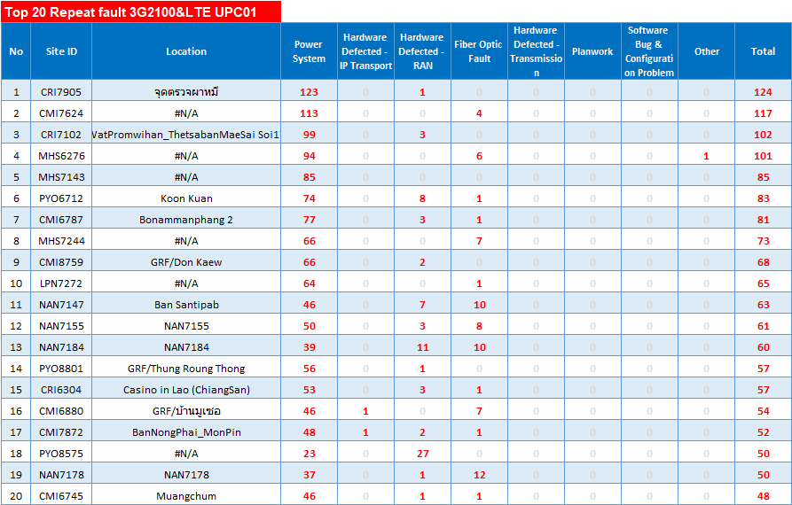
(3G2100&LTE) Top 20 Repeat Fault by cause Nor.1 (SA)
Managed Service

Slide 34

(2G+LTE900) Repeat Fault Apr 2023 (SA)
Repeat Fault all
Managed Service

Slide 35
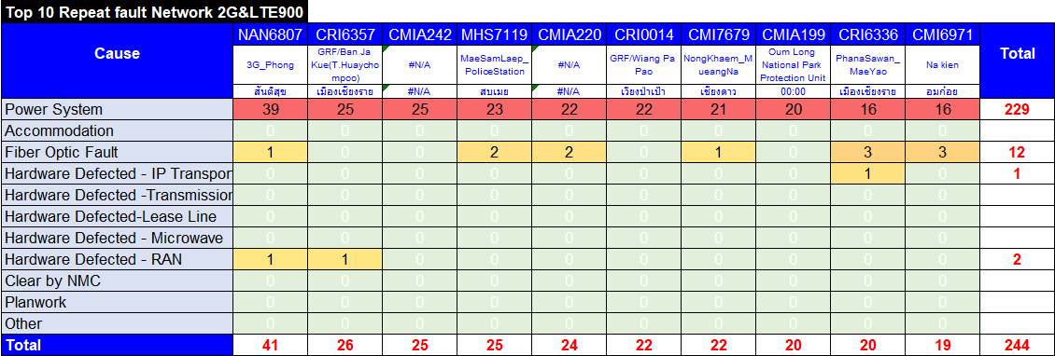
(2G+LTE900) Repeat Fault May 2023 (SA)
Repeat Fault all
Managed Service

Slide 36
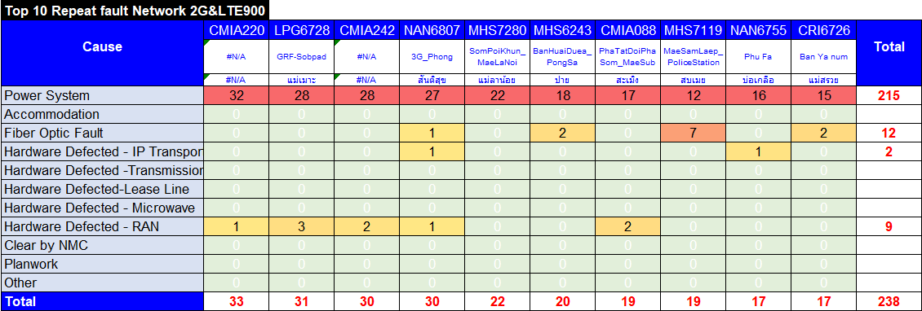
(2G+LTE900) Repeat Fault Jun 2023 (SA)
Repeat Fault all
Managed Service

Slide 37
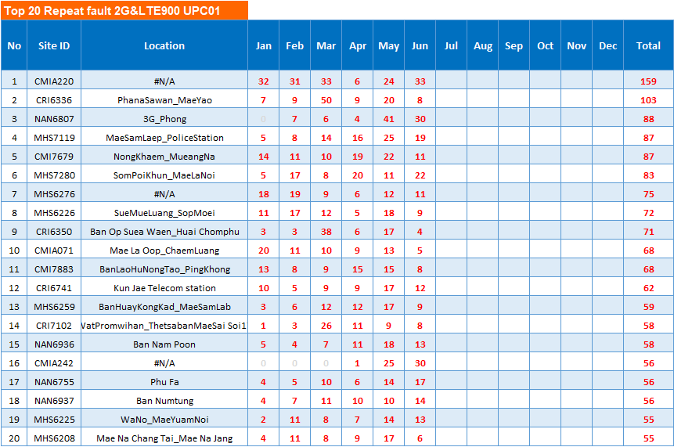
(2G+LTE900) Top 20 Repeat Fault by ticket Nor.1 (SA)
Managed Service

Slide 38
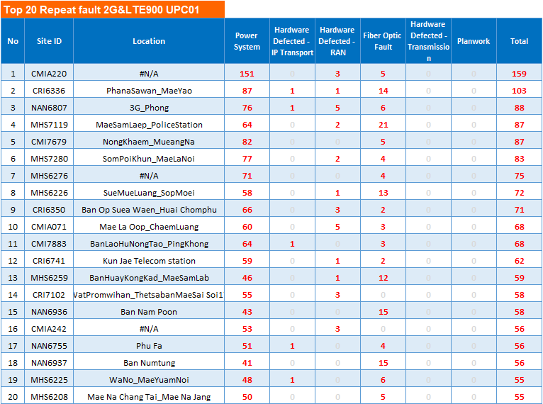
(2G+LTE900) Top 20 Repeat Fault by cause Nor.1 (SA)
Managed Service

Slide 39
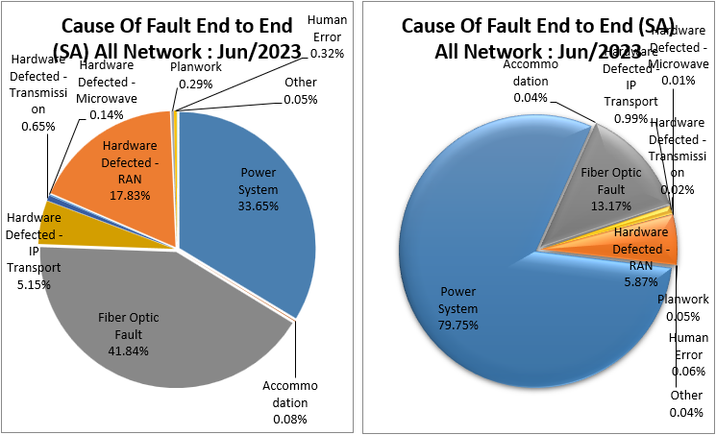
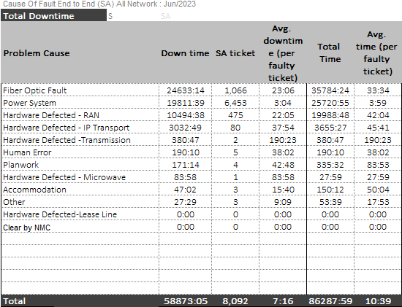

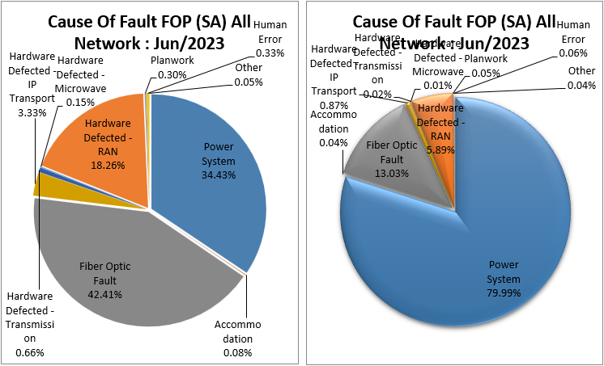
Percentage ของ Cause Of Faultแยกตาม Downtime
Percentage ของ Cause Of Faultแยกตามจำนวน SA Ticket
(All) Cause of Fault (SA)
Managed Service

Slide 40
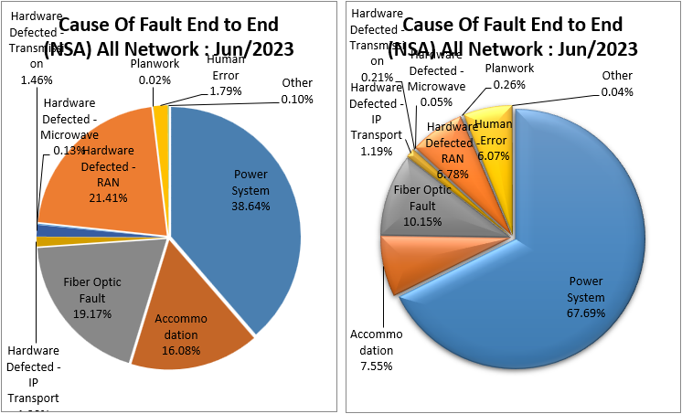
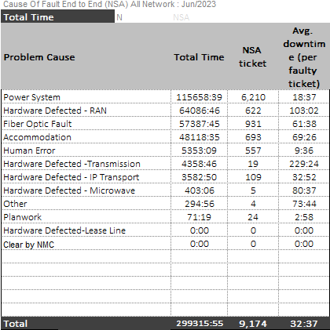
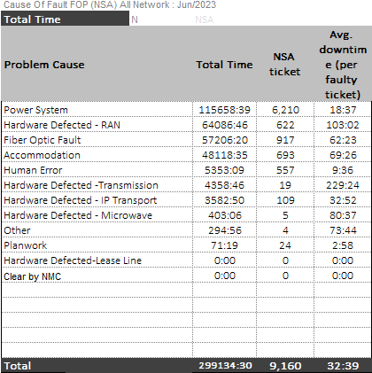
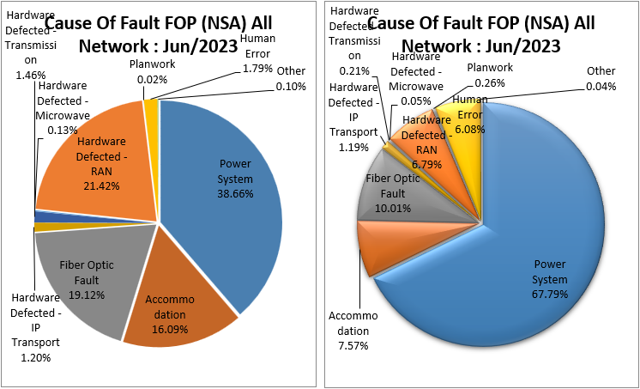
Percentage ของ Cause Of Faultแยกตาม Total time
Percentage ของ Cause Of Faultแยกตามจำนวน NSA Ticket
(All) Cause of Fault (NSA)
Managed Service

Slide 41
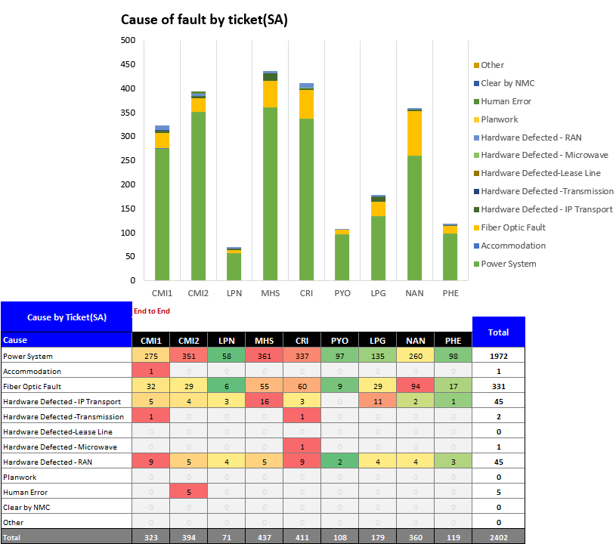
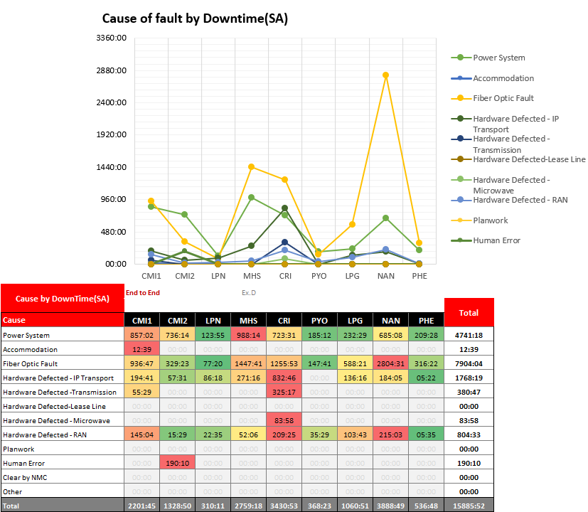
(3G850) Cause of Fault (SA) by Province
Managed Service

Slide 42
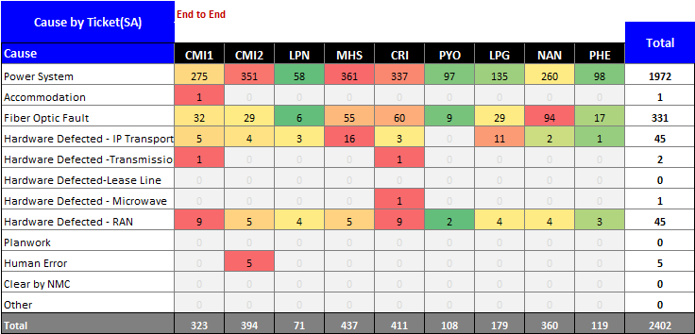

(3G850) Num vs. Fault rate Cause of Fault (SA) by Province
Managed Service

Slide 43


(3G2100&LTE) Cause of Fault (SA) by Province
Managed Service

Slide 44


(3G2100&LTE) Num vs. Fault rate Cause of Fault (SA) by Province
Managed Service

Slide 45


(2G+LTE900) Cause of Fault (SA) by Province
Managed Service

Slide 46


(2G+LTE900) Num vs. Fault rate Cause of Fault (SA) by Province
Managed Service

Slide 47


Ticket Over SLA Jun 2023
Managed Service

Slide 48

Ticket Over SLA Jun 2023
Managed Service

Slide 49


Ticket Over SLA Jan - Jun 2023
Managed Service

Slide 50




Fault Fiber cut (SA&NSA) E2E
Y2020
Y2021
Y2022
Y2023
Managed Service

Slide 51

Fault Fiber cut (SA&NSA) E2E
Managed Service

Slide 52


together
we can make
it
The End
Managed Service

